Slide 1
Machine Learning
Classification and Regression

Slide 2
Heart failure prediction
Dataset: https://www.kaggle.com/andrewmvd/heart-failure-clinical-data?fbclid=IwAR2l8MikAl9a0a_LiZqlyBa11E8VFxw7xgd9_m8NwwzprLtXDDJgx-UhcUc
Number of features: 13
Number of instances: 309

Slide 3
Feature Descriptons
Key Feature Description:
age (int)
sex (binary)
anemia (boolean) – Decrease of red blood cells
diabetes (boolean) – If a patient has diabetes or not
ejection_fraction (double) – % of blood leaving the heart at each contraction
high_blood_presure (boolean) – If a patient has hypertension
platelets (double) – Thrombocytes (kilo/mL)
serum_ceratinine,
seruim_sodium (double) – Level in blood (mg/dL)

Slide 4
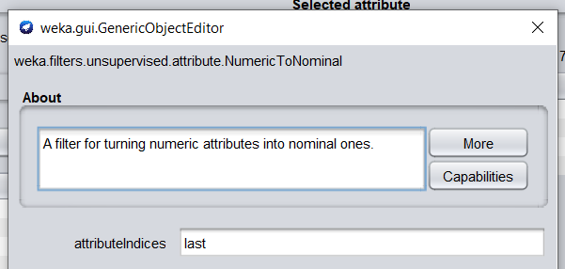
Data preprocessing
NumericToNominal for attribute DEATH_EVENT

Slide 5
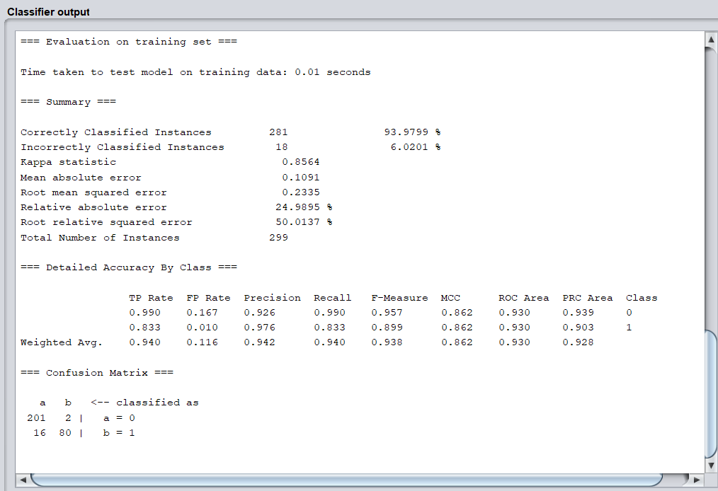
trees.J48 Classifier output

Slide 6
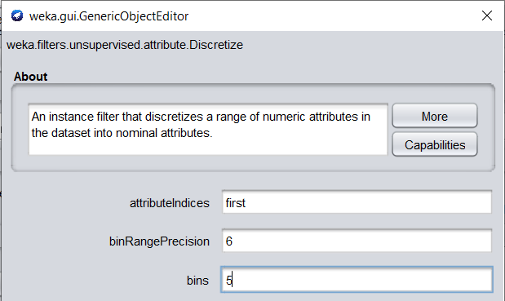
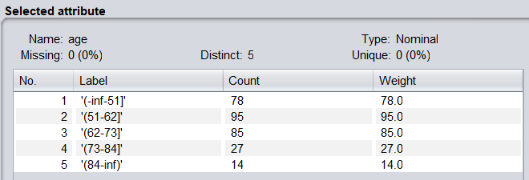
Data preprocessing
Discretize age in 5,10,15 bins

Slide 7
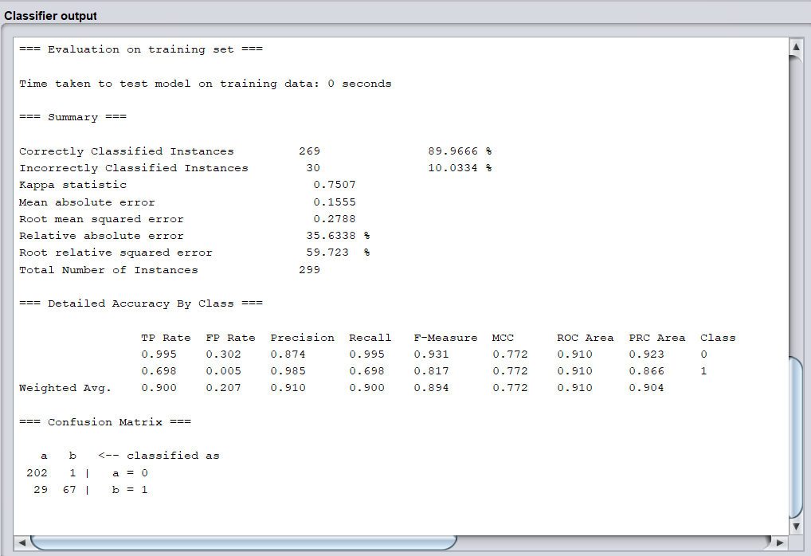
trees.J48 Classifier output
Age 10 bins

Slide 8
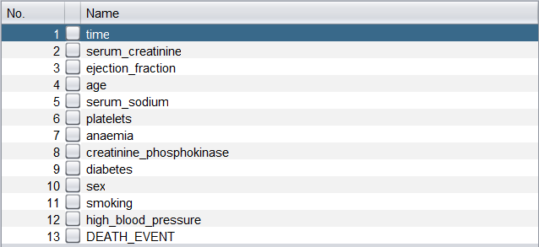
Select features with Weka Attribute Selector

Slide 9
Select features with Weka Attribute Selector

Slide 10
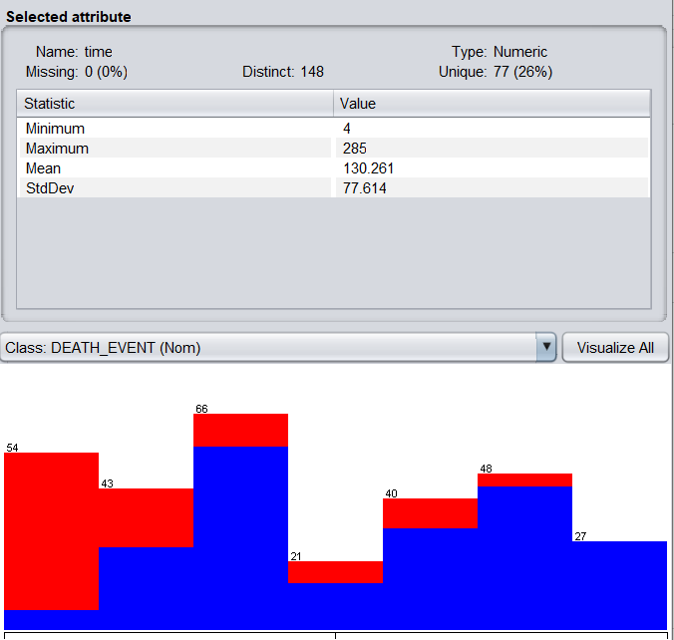

Slide 11
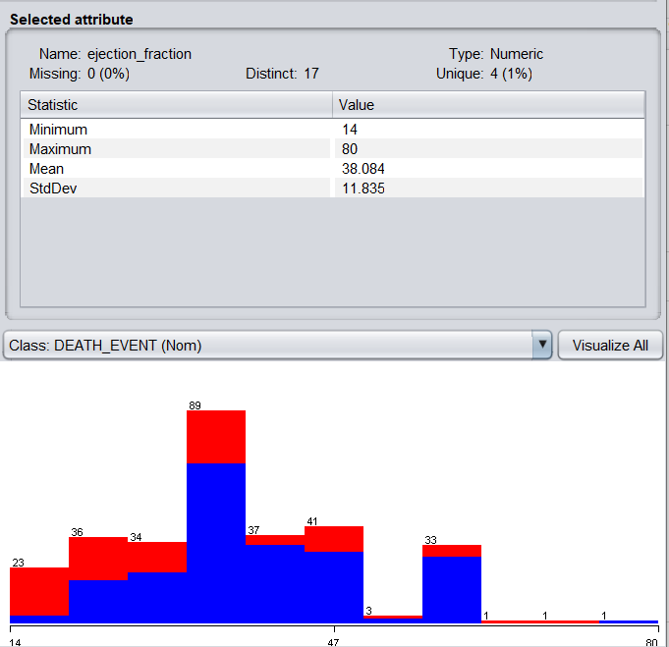

Slide 12
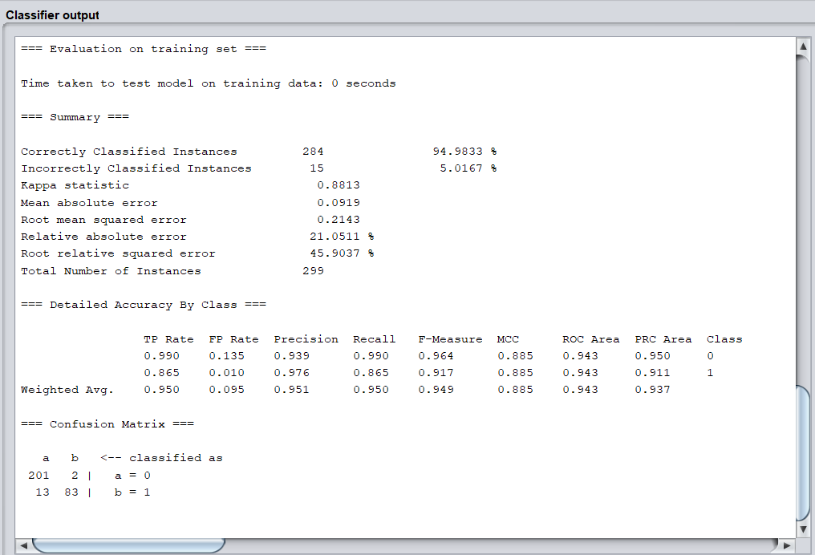
trees.J48 Classifier output
Best result

Slide 13
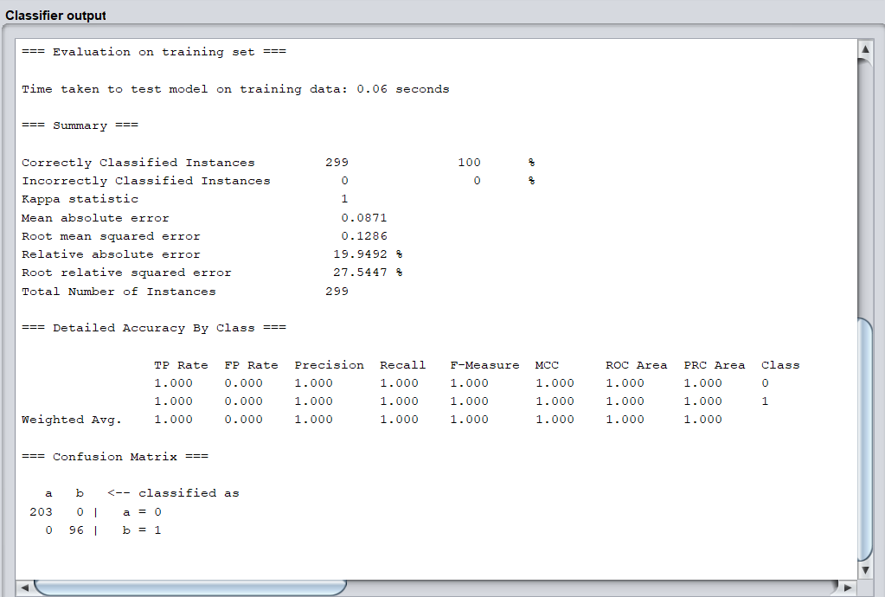
Random Forest Classifier output

Slide 14
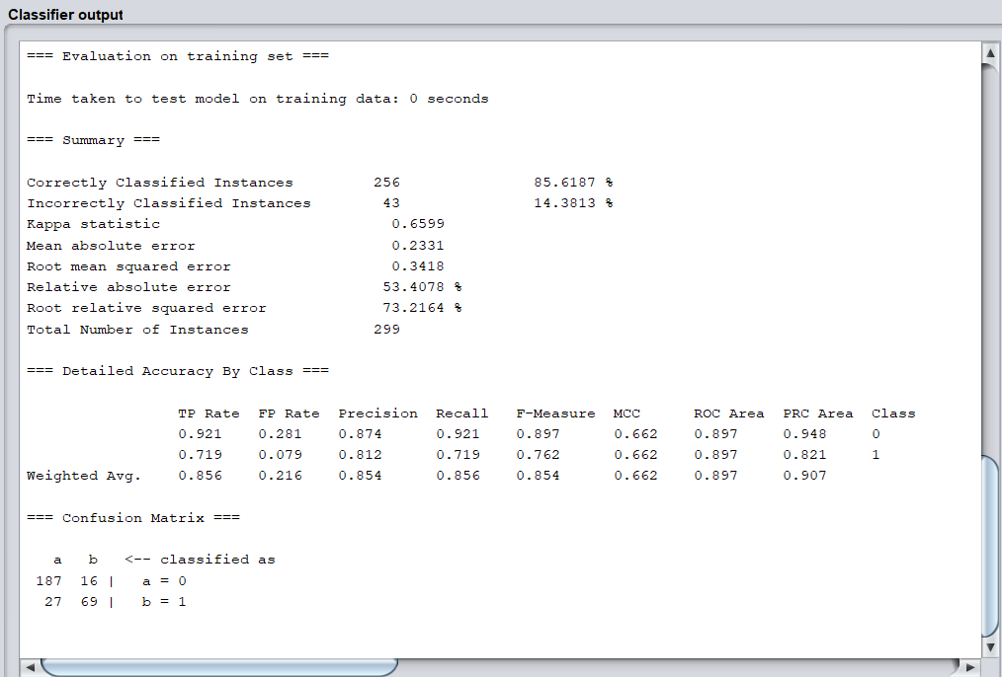
Logistic Classifier output

Slide 15
Car Price Prediction
Dataset: https://www.kaggle.com/nehalbirla/vehicle-dataset-from-cardekho
Number of features: 8
Number of instances: 4340

Slide 16
Feature Descriptions
Key Feature Description:
Name (String): Name of the cars
Year (Int): Year of the car when it was bought
Selling_price (Int): Price at which the car is being sold
Km_driven (Int): Number of Kilometres the car is driven
Fuel (String): Fuel type of car (petrol / diesel / CNG / LPG / electric)
Seller_type (String): Tells if a Seller is Individual or a Dealer
Transmission (String): Gear transmission of the car (Automatic/Manual)
Owner (String): Number of previous owners of the car.

Slide 17
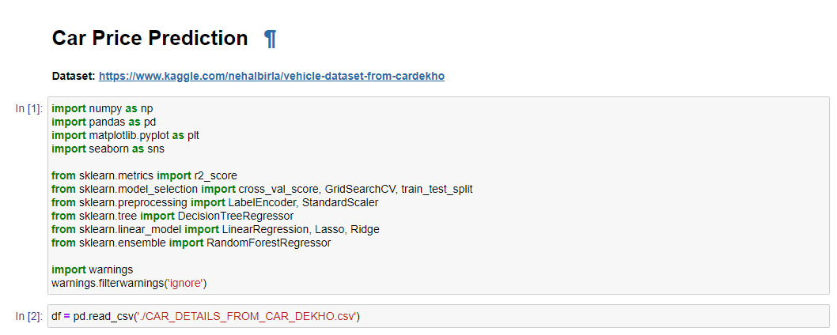

Slide 18
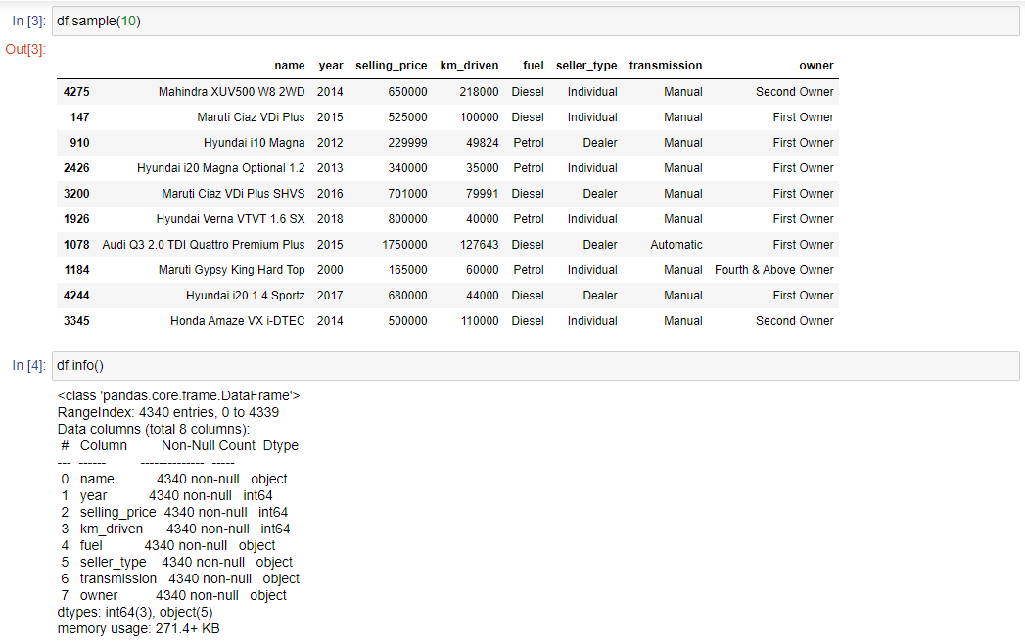

Slide 19
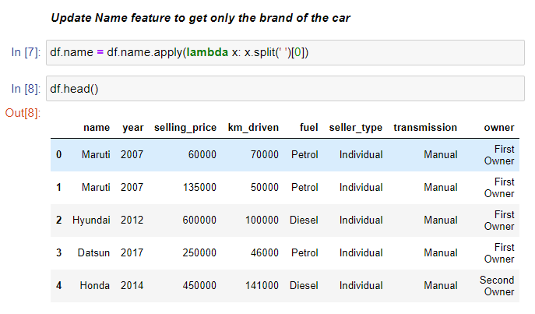

Slide 20
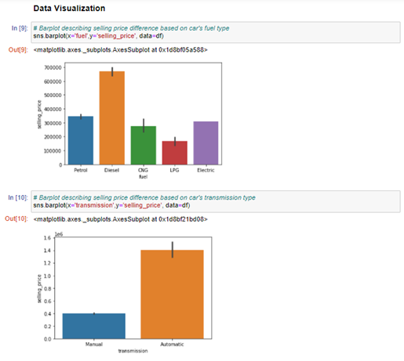
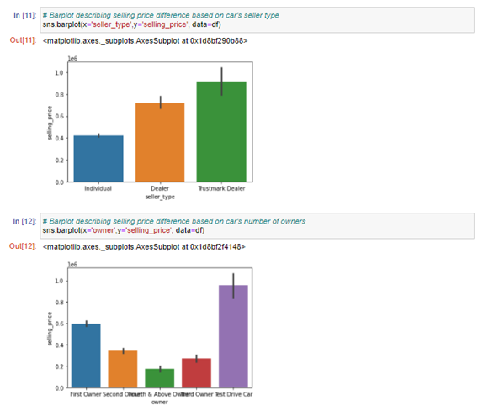

Slide 21
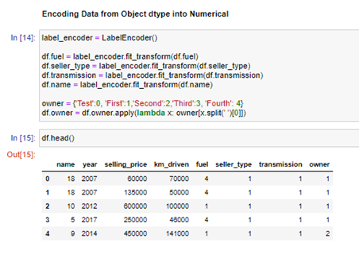
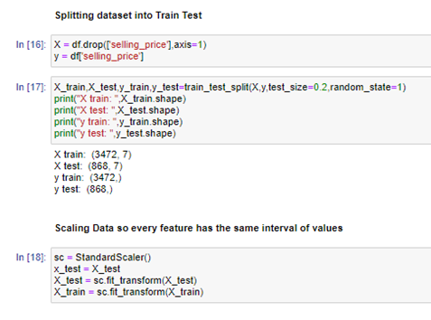

Slide 22
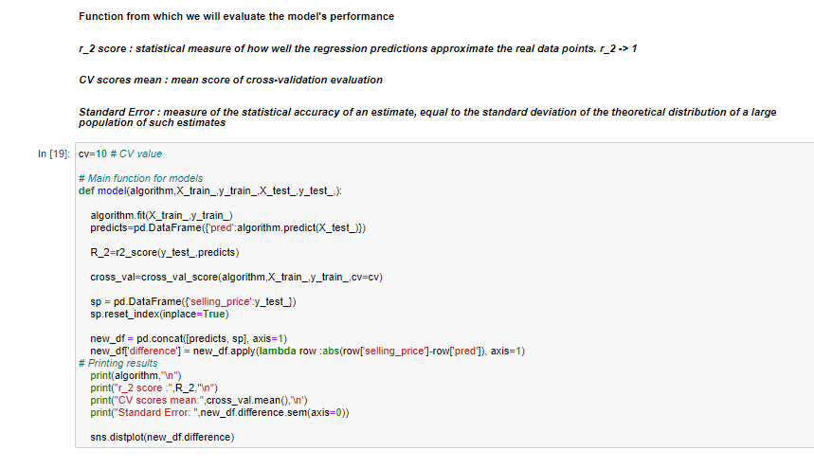

Slide 23
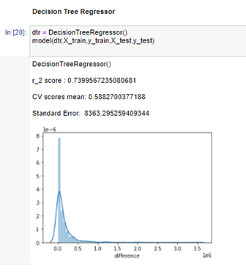
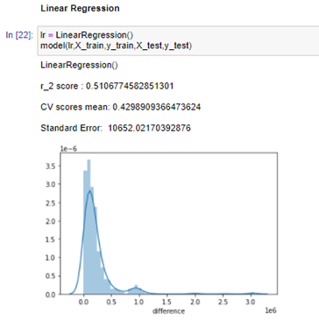
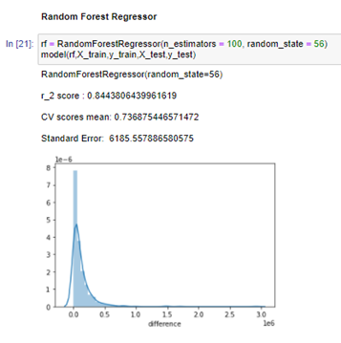

Slide 24
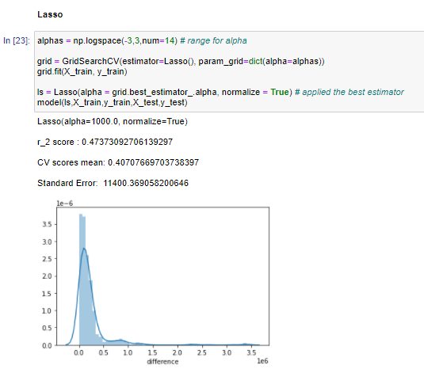
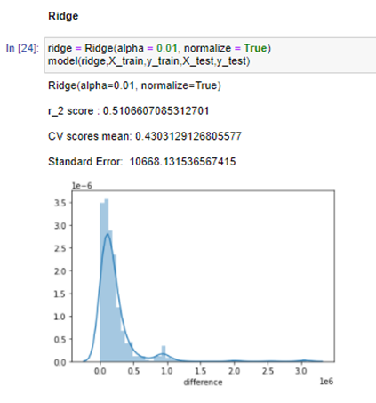

Slide 25
Heart Disease Prediction
Dataset: https://www.kaggle.com/ronitf/heart-disease-uci
Number of features: 14
Number of instances: 303

Slide 26
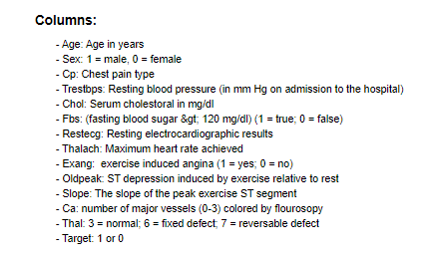
Feature Descriptions
Key Feature Description:

Slide 27
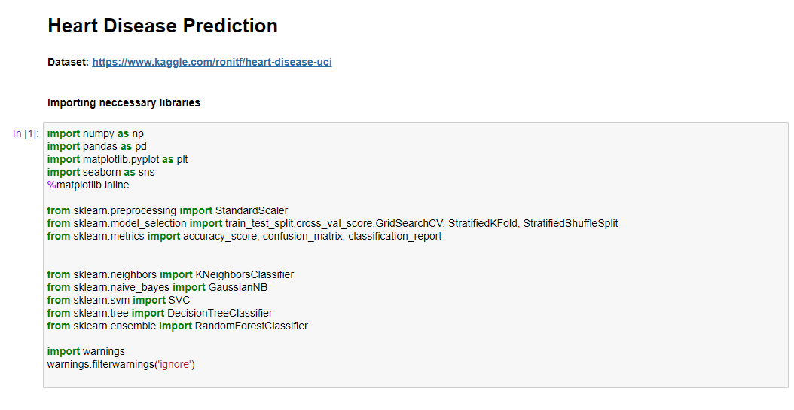

Slide 28
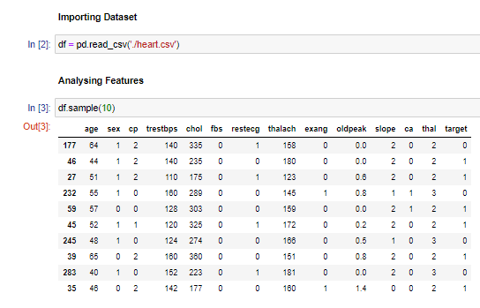
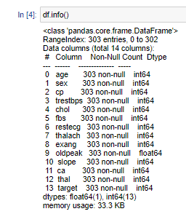

Slide 29
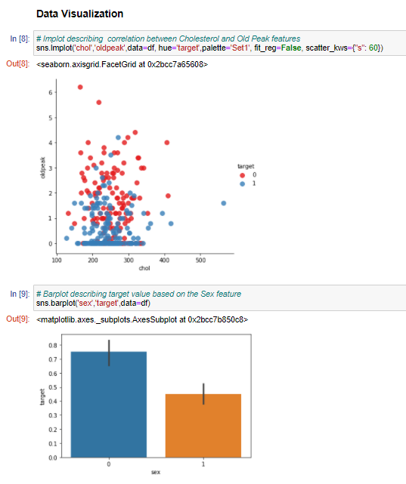
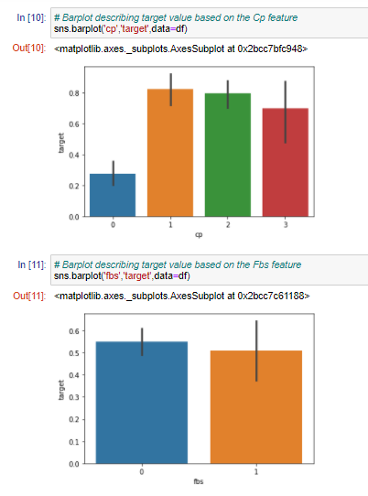

Slide 30
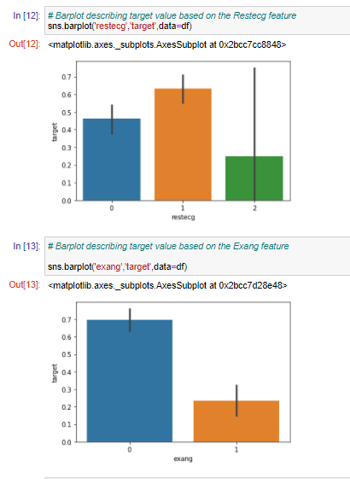
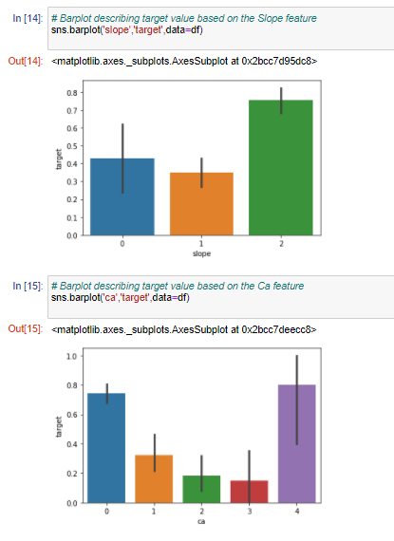

Slide 31
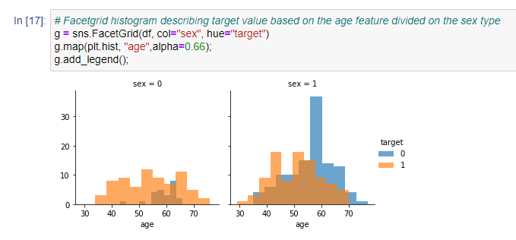
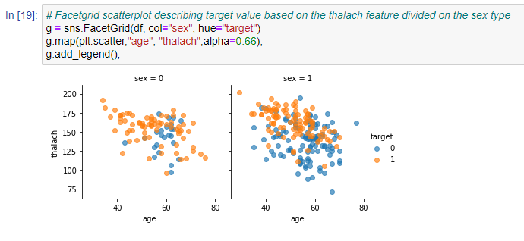

Slide 32
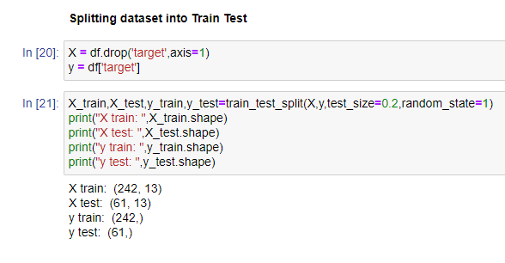
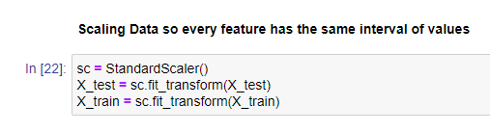

Slide 33
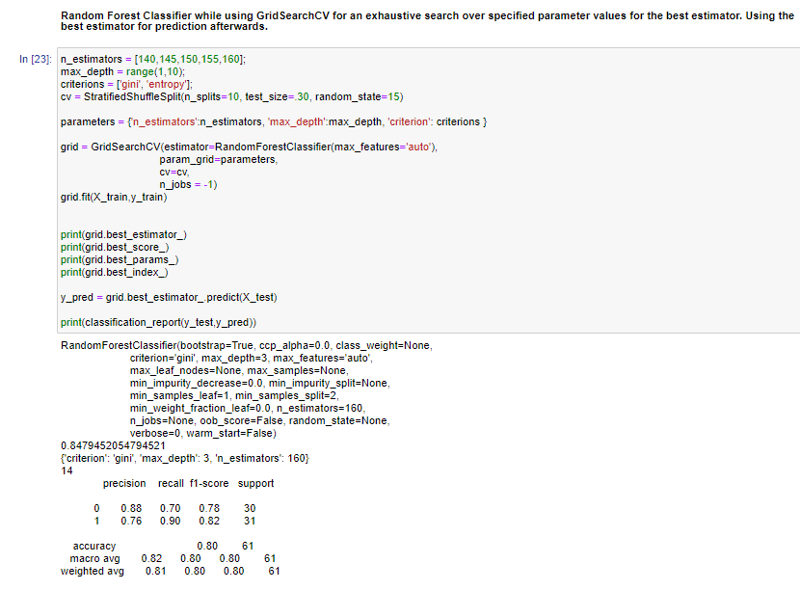

Slide 34
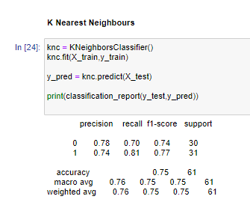
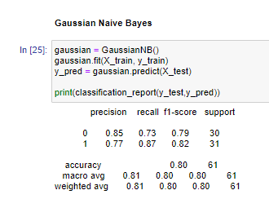
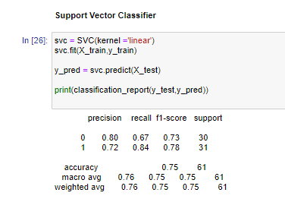

Slide 35
Job Posting Authenticity
Dataset: : https://www.kaggle.com/shivamb/real-or-fake-fake-jobposting-prediction
Number of features: 18
Number of rows: 17880

Slide 36
Feature Descriptions
Key Feature Description:
department (string) - Corporate department (e.g. sales).
fraudility (boolean) - Posting is genuine or fake
company_profile (string) – A brief company description
description (string) – Job Description
requirements (string) – Listed Requirements
telecommuting (boolean) - True for telecommuting positions.
has_company_logo (boolean) – True if company logo is present
has_questions (boolean) – True if screening questions are present
employment_type (string) - Full-type, Part-time, Contract, etc.
required_experience (string) - Executive, Entry level, Intern, etc.
industry (string) - Automotive, IT, Health care, Real estate, etc.

Slide 37
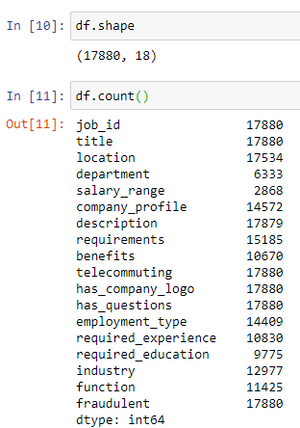
Exploring dataset

Slide 38
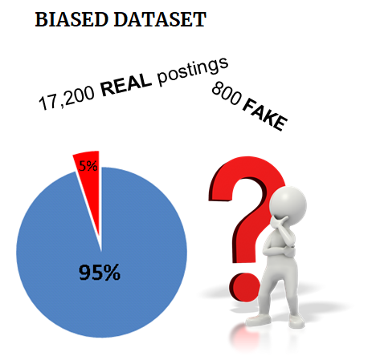
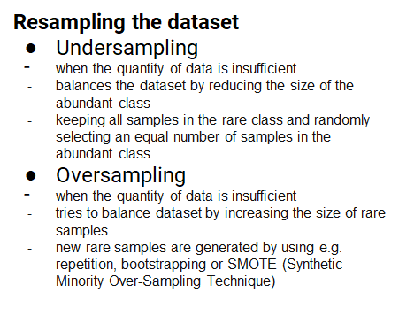
Challenge

Slide 39
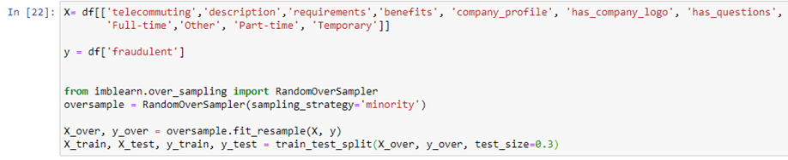
Oversampling implementation

Slide 40
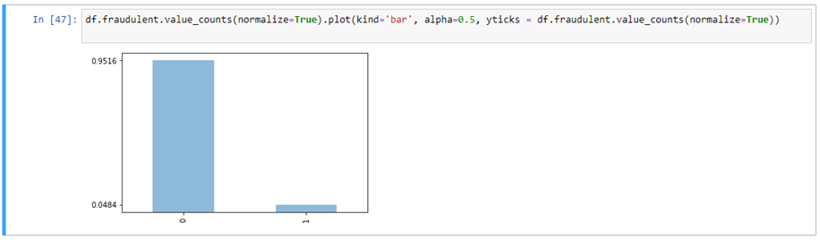
Observation of imbalanced data

Slide 41
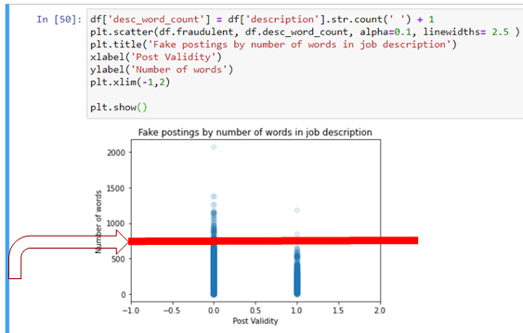
Fake job postings are more likely to have less words in the job description.. right?
The number of fraudulent job postings experiences a steep decrease in cases where the number of words in the job description is higher than
750.

Slide 42
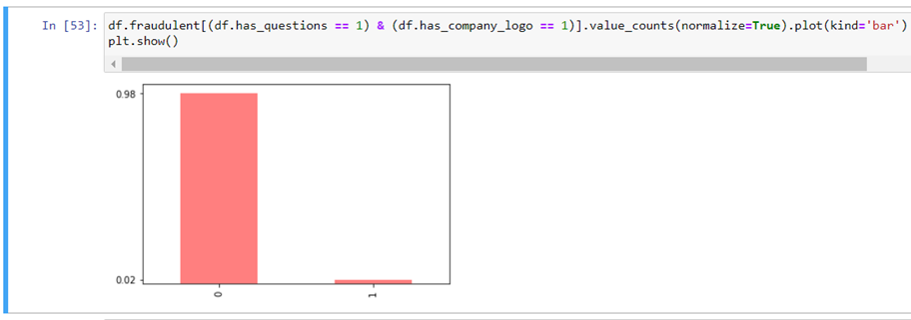
Real companies are more likely to have questions for you and a company logo.

Slide 43
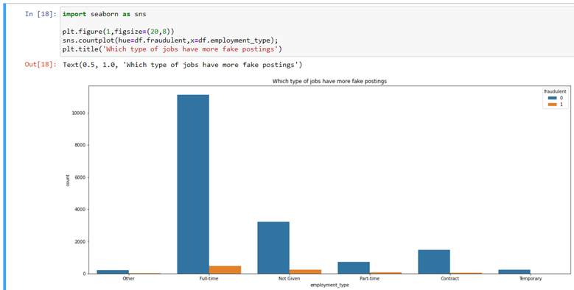
Postings grouped by employment type.

Slide 44
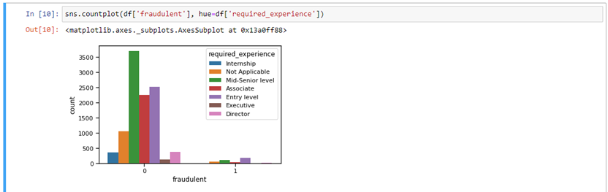
The trend based on required_experience feature.

Slide 45
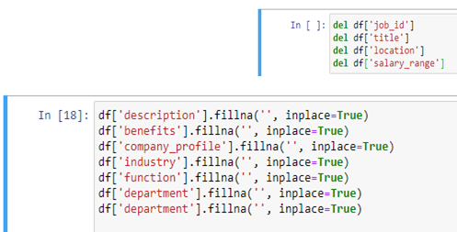
Data Preprocessing
Deletion of unnecessary features and filling missing data.

Slide 46

Data Preprocessing
Replace text fields with the length of the text for each of the following columns.

Slide 47


Slide 48


Predicting and results

Slide 49


Predicting and results

Slide 50
Student Grade Prediction
Dataset: https://www.kaggle.com/dipam7/student-grade-prediction
Number of features: 33
Number of instances: 395

Slide 51
Feature Descriptions
Key Feature Description:
Sex: student's sex (binary: 'F' - female or 'M' - male)
Age: student's age (numeric: from 15 to 22)
Address: student's home address type (binary: 'U' - urban or 'R' - rural)
Studytime: weekly study time (numeric: 1 - <2 hours, 2 - 2 to 5 hours, 3 - 5 to 10 hours, or 4 - >10 hours)
Traveltime: home to school travel time (numeric: 1 - <15 min., 2 - 15 to 30 min., 3 - 30 min. to 1 hour, or 4 - >1 hour)
Failures: number of past class failures (numeric: n if 1&lt;=n&lt;3, else 4)
Dalc: workday alcohol consumption (numeric: from 1 - very low to 5 - very high)
Health: current health status (numeric: from 1 - very bad to 5 - very good)
Absences: number of school absences (numeric: from 0 to 93)
G3: final grade (numeric: from 0 to 20)

Slide 52


Data preprocessing
Turn Nominal Attributes into Binary Attributes
Scaling dataset values so every attribute have the same interval of values

Slide 53

Gaussian Processes output
Implements Gaussian processes for regression without hyperparameter-tuning
Batch Size : 100
Noise : 1
Kernel : PolyKernel
Seed : 1

Slide 54

Linear Regression output
Class for using linear regression for prediction.
Batch Size : 100
Ridge : 1.0E-8

Slide 55

SMOreg output
SMOreg implements the support vector machine for regression.
Batch Size : 100
c : 1
Kernel : PolyKernel

Slide 56

Multilayer Perceptron output
A classifier that uses backpropagation to learn a multi-layer perceptron to classify instances.
Batch Size : 100
Learning Rate : 0.03
Training Time : 1200

Slide 57
NBA All Star Prediction
Datasets :
https://www.kaggle.com/drgilermo/nba-players-stats?select=Seasons_Stats.csv
Number of features: 53
Number of instances: 24.7K
https://www.kaggle.com/fmejia21/nba-all-star-game-20002016/version/2?select=NBA+All+Stars+2000-2016+-+Sheet1.csv
Number of features: 9
Number of instances: 439

Slide 58
Feature Descriptions
Year (numeric): Season year
Player (string) : Player’s full name
Pos (string) : Position
Age (numeric): Player’s age
Tm (string): Team’s name
Gs (numeric): Games Started throughout the season
Mp (numeric): Minutes played throughout the season
Trb (numeric): Total Rebounds throughout the season
Ast (numeric): Assists throughout the season
Pts (numeric): Points throughout the season

Slide 59


Slide 60



Slide 61



Slide 62


Slide 63



Slide 64


Slide 65



Slide 66




Slide 67



